Slide 1
Software Development Lifecycles Models

Slide 2
SDLC Models
A software development life cycle (SDLC) model is a conceptual framework describing all activities in a software development project from planning to maintenance. Most of the models are graphical models, which are drawn representations that employ agreed-upon symbols and conventions.

Slide 3
SDLC Models (cont’d)
SDLC Models
Predictive
e.g. waterfall, prototyping, RAD
Adaptive
e.g. Spiral, Agile, DDSDM
predictive SDLC assumes you can predict the complete workflow. It involves fully understanding the final product and determining the process for delivering it. In this form of project life cycle, you determine the cost, scope, and timeline in the early phases of the project.
Adaptive SDLC approaches have a mix of incremental and iterative development. It involves adding features incrementally and making changes and refinements according to feedback. In other words, the work can easily adapt to the changing requirements based on new feedback received from the client.

Slide 4
Adaptive Models
Spiral
Agile
DSDM

Slide 5
Adaptive Models - Spiral
“The spiral model is a risk-driven software development process model. Based on the unique risk patterns of a given project, the spiral model guides a team to adopt elements of one or more process models, such as incremental, waterfall, or evolutionary prototyping.”

Slide 6
Adaptive Models - Spiral
Also called a meta model since it encompasses all other life cycle models.
Risk handling is built into this model.
Model appears like a spiral with many loops.
Number of loops can Vary.
A single loop of the spiral represents a phase of the software process.
Spiral Model includes the iterative nature of the prototyping model and the linear nature of the waterfall model.

Slide 7
Adaptive Models - Spiral
Planning Phase: Requirements are gathered during the planning phase (Business Requirement Specifications-BRS & System Requirement specifications-SRS)
Risk Analysis: In the risk analysis phase, a process is undertaken to identify risk and alternate solutions (prototype is produced at the end of the risk analysis phase & If any risk is found during the risk analysis then alternate solutions are suggested and implemented).
Engineering Phase: In this phase software is developed, along with testing at the end of the phase (development and testing is done in this phase).
Evaluation phase: This phase allows the customer to evaluate the output of the project to date before the project continues to the next spiral.

Slide 8
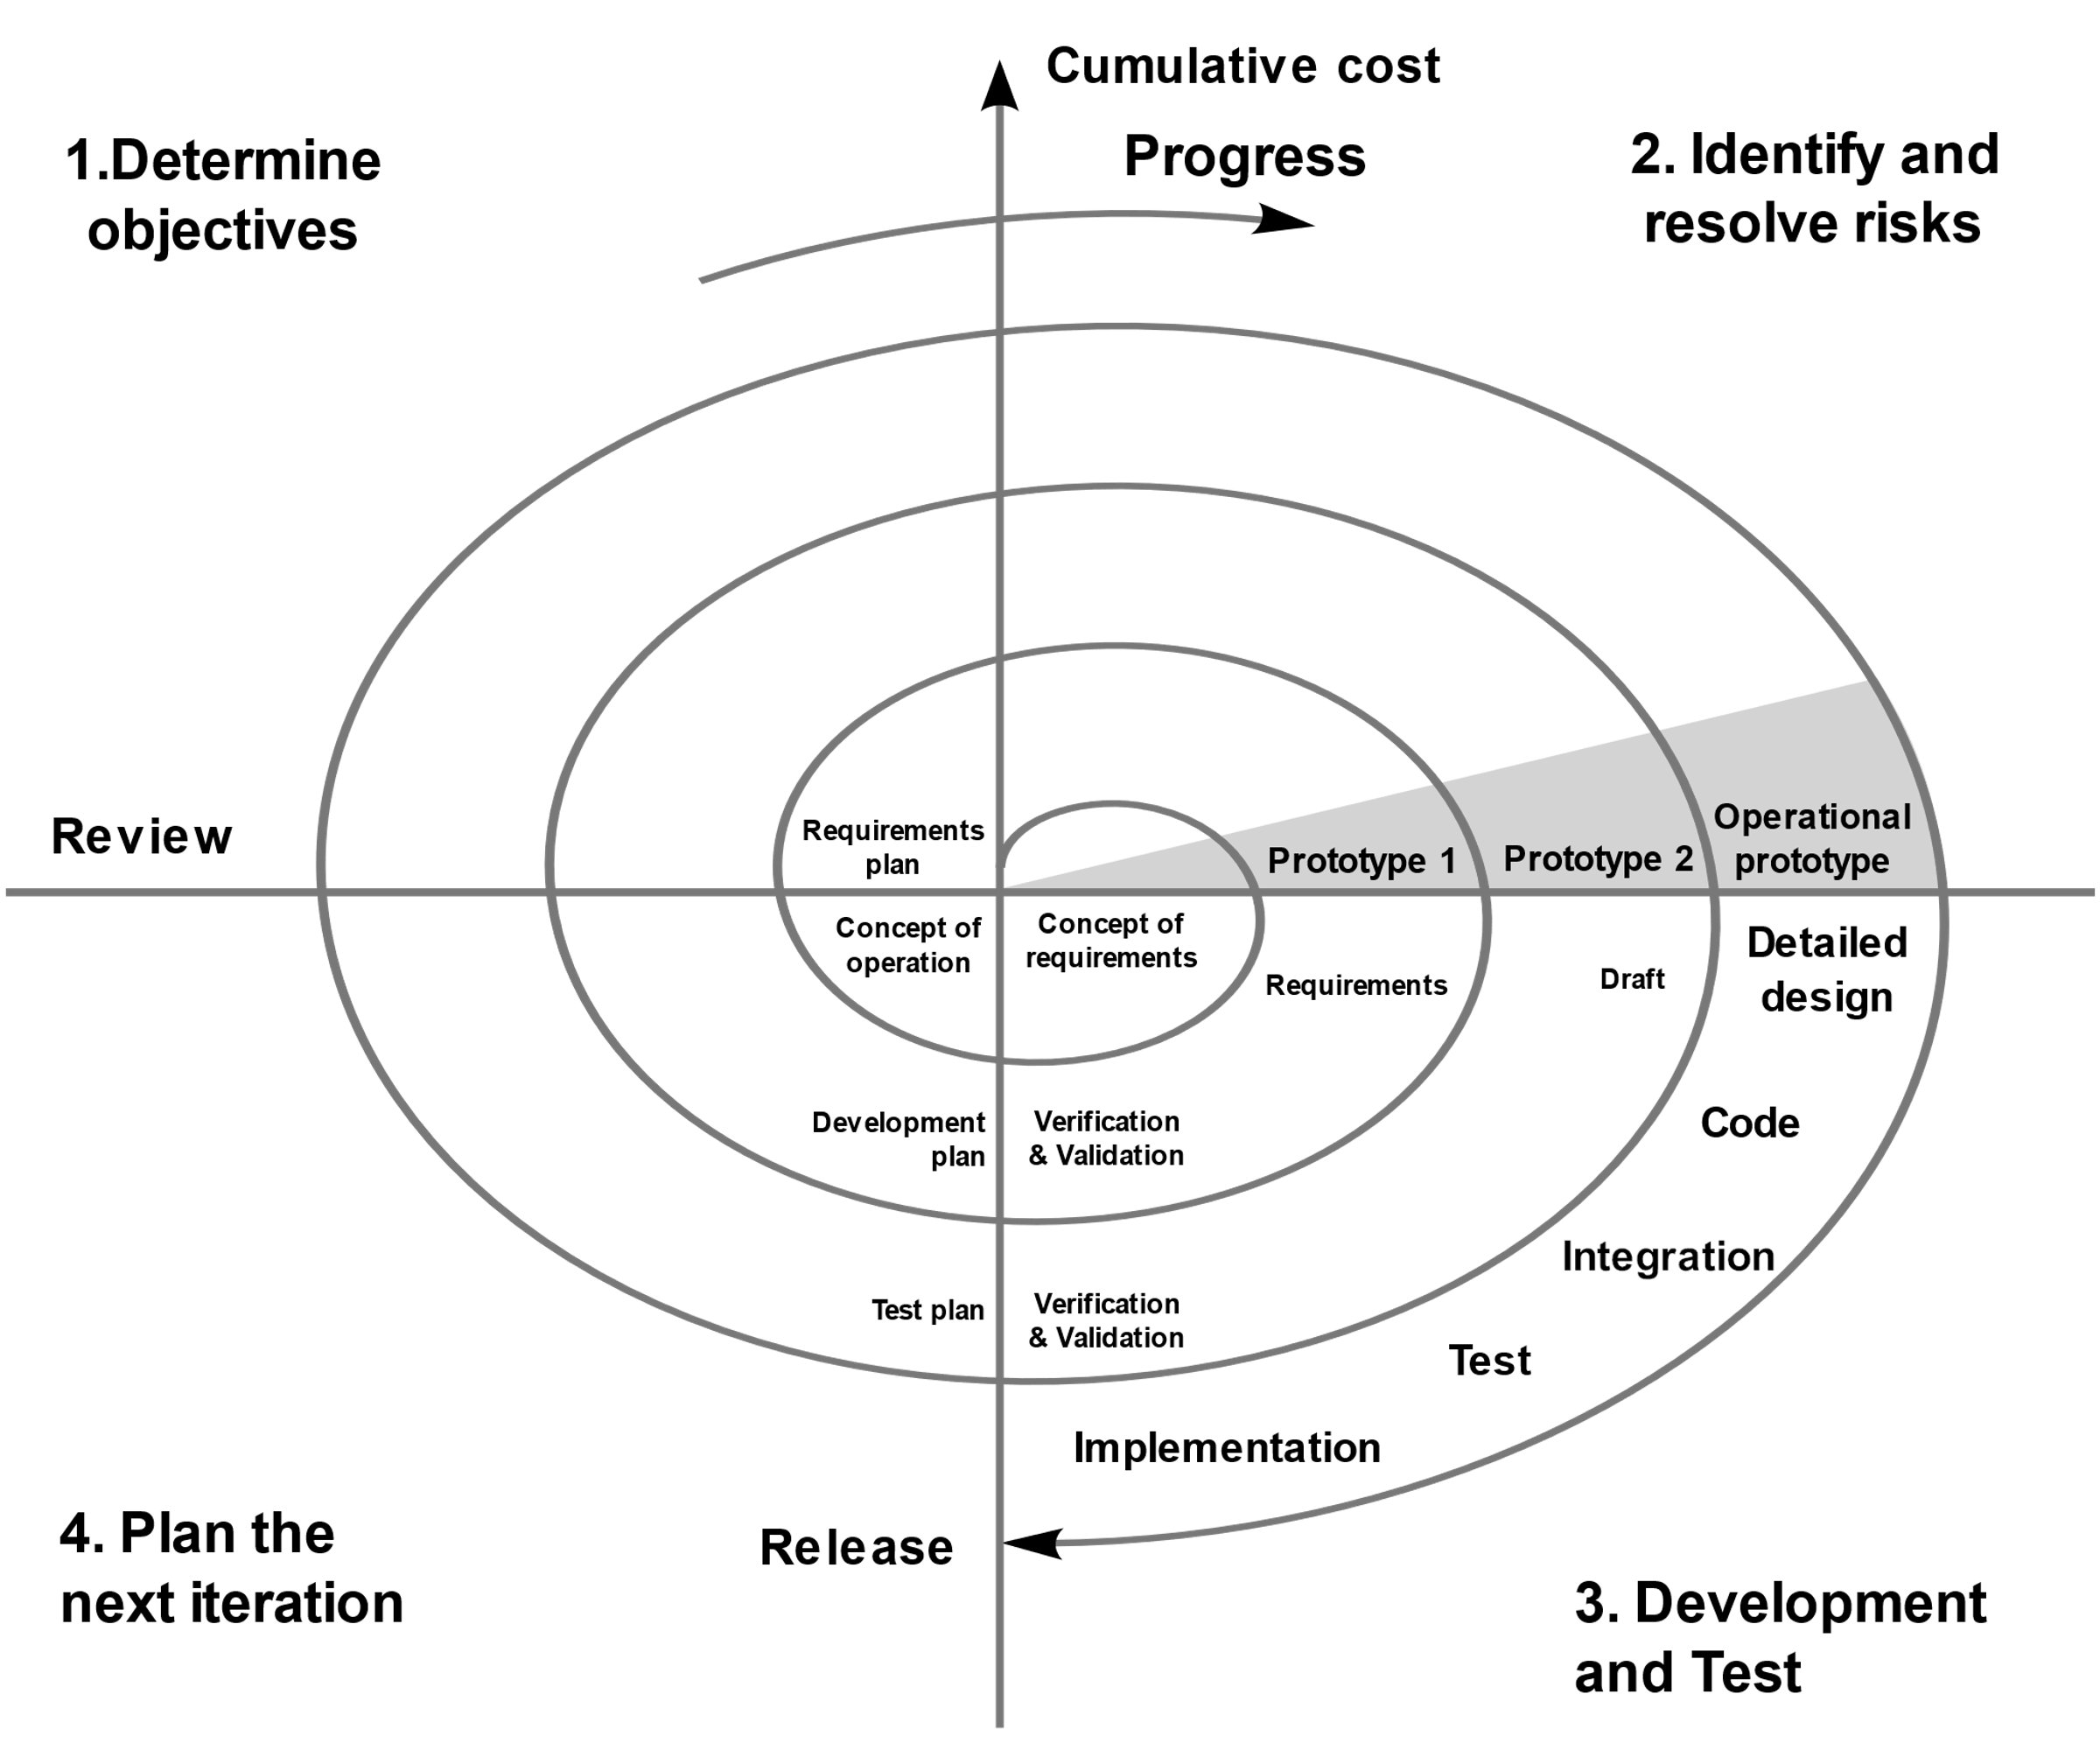
Adaptive Models - Spiral

Slide 9
Advantages of the Spiral Model
High amount of risk analysis to avoid risk.
Good for large and mission-critical projects.
Strong approval and documentation control.
Additional Functionality can be added later.
Software is produced early in the software life cycle.

Slide 10
Disadvantages of the Spiral Model
Can be a costly model to use.
Risk analysis requires highly specific expertise.
Project’s success is heavily dependent on the risk analysis phase.
Doesn’t work well for smaller projects.

Slide 11
When to use the Spiral Model
When costs and risk evaluation is important
For medium to high-risk projects
Long-term project commitment unwise because of potential changes to economic priorities
Users are unsure of their needs
Requirements are complex
New product line
Significant changes are expected (research and exploration)

Slide 12
Adaptive Models - Agile
“Agile modeling (AM) is a methodology for modeling and documenting software systems based on best practices. It is a collection of values and principles, that can be applied on an (agile) software development project. This methodology is more flexible than traditional modeling methods, making it a better fit in a fast-changing environment.”

Slide 13
Adaptive Models - Agile
Agile development model is also a type of Incremental model.
Software is developed in incremental, rapid cycles.
This results in small incremental releases with each release building on previous functionality.
Each release is thoroughly tested to ensure software quality is maintained.
It is used for time critical applications.
Extreme Programming (XP) is currently one of the most well known agile development life cycle model.

Slide 14
????????????
Planning Phase: Requirements are gathered during the planning phase (Business Requirement Specifications-BRS & System Requirement specifications-SRS)
Risk Analysis: In the risk analysis phase, a process is undertaken to identify risk and alternate solutions (prototype is produced at the end of the risk analysis phase & If any risk is found during the risk analysis then alternate solutions are suggested and implemented).
Engineering Phase: In this phase software is developed, along with testing at the end of the phase (development and testing is done in this phase).
Evaluation phase: This phase allows the customer to evaluate the output of the project to date before the project continues to the next spiral.

Slide 15
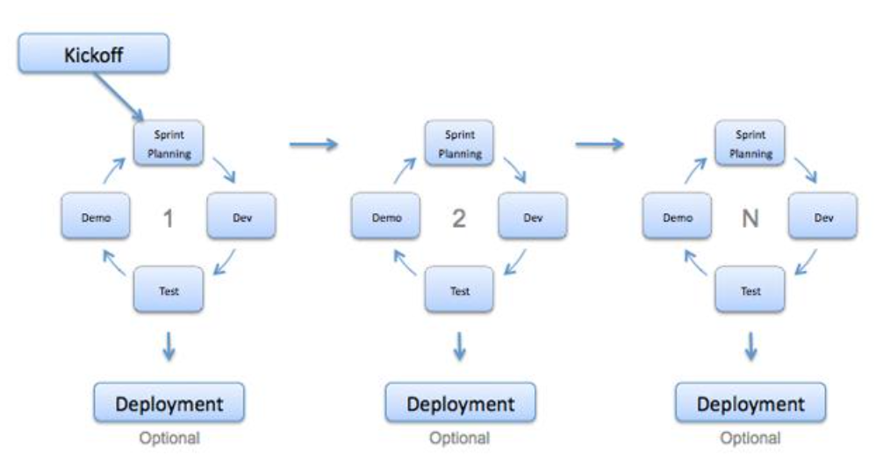
Adaptive Models - Agile

Slide 16
Advantages of the Agile Model
Customer satisfaction by rapid, continuous delivery of useful software.
People and interactions are emphasized rather than process and tools.
Customers, developers and testers constantly interact with each other.
Working software is delivered frequently (weeks rather than months).
Face-to-face conversation is the best form of communication.
Daily cooperation between businesspeople and developers.
Continuous attention to technical excellence and good design.
Adaptation to changing circumstances.
Late changes in requirements are welcomed

Slide 17
Disadvantages of the Agile Model
In case of some software deliverables, especially the large ones, it is difficult to assess the effort required at the beginning of the software development life cycle.
There is lack of emphasis on necessary designing and documentation.
The project can easily go off track if the customer representative is not clear what outcome that they want.
Only senior programmers are capable of taking the kind of decisions required during the development process.
Risky for new programmers, unless combined with experienced resources.

Slide 18
Adaptive Models - DSDM
“Is an agile project delivery framework, initially used as a software development method.[1][2] First released in 1994, DSDM originally sought to provide some discipline to the rapid application development (RAD) method.[3] In later versions the DSDM Agile Project Framework was revised and became a generic approach to project management and solution delivery rather than being focused specifically on software development and code creation, and it could be used for non-IT projects”

Slide 19
Adaptive Models - DSDM
The DSDM Agile Project Framework covers a wide range of activities across the whole project lifecycle such as:
Strong foundations and governance, which set it apart from some other Agile methods.
Iterative and incremental approach that embraces principles of Agile development, including continuous user/customer involvement
DSDM fixes cost, quality and time at the outset and uses the MoSCoW prioritization of scope into musts, shoulds, coulds and will not haves to adjust the project deliverable to meet the stated time constraint.
DSDM is one of a number of agile methods for developing software and non-IT solutions, and it forms a part of the Agile Alliance.

Slide 20
Adaptive Models – DSDM Phases
Pre-project. Helps start the project correctly and prevents poor projects beginning.
Feasibility. Check the project is technically feasible, and the business case is viable.
Foundations. Teams spend a few weeks establishing the business rationale, the technical solution and approach.
Evolutionary development. Teams build increments of prioritized features in iterations of the system.
Bring the system into operational use.
Post-project.

Slide 21
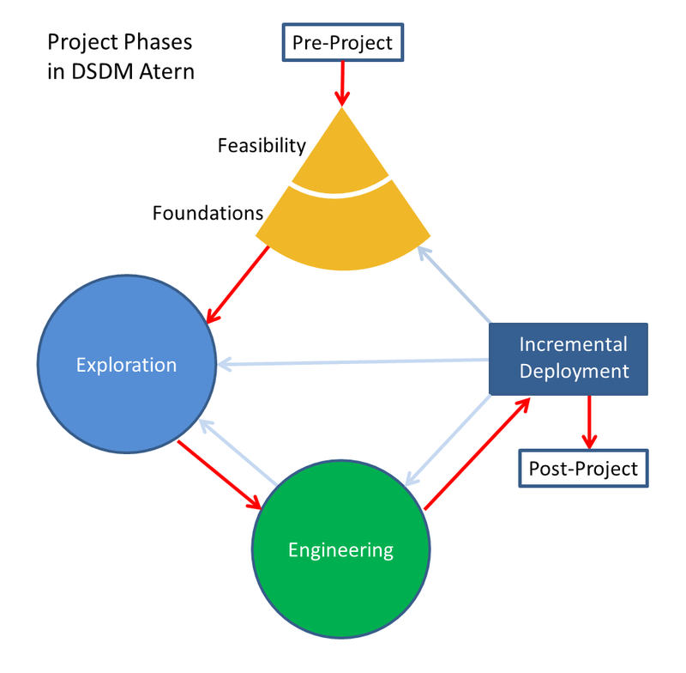
Adaptive Models - DSDM

Slide 22
Advantages of the DSDM Model
Improves collaboration
Help to enhance communication efforts across various cross-functional teams and departments.
Minimize confusion since everyone remains updated on the latest developments that occur within the project.
Supports rapid deliverables
Allows product teams to release their deliverables rapidly, minimizing delays and attending to a reasonable timeline.
Helps teams increase efficiency, meet client needs and achieve a launch sooner.

Slide 23
Advantages of the DSDM Model cont.
Promotes feedback
Encourages teams to stay in close communication with interested parties to receive frequent feedback and suggestions.
Enhances project organization
There are a variety of tools and strategies they can use to help better manage the overall operation.
Sets clear guidelines
Help teams manage their efforts to ensure they meet deadlines and stay within the budget.

Slide 24
Disadvantages of the DSDM Model
Requires resources
Can be costly to implement. Although it requires an investment to implement, it may also save an organization money by encouraging teams to work efficiently and reducing time-to-market for products.
Minimizes creativity
It encourages developers to work quickly, it may limit risk-taking. The focus on iterative development may allow professionals to revisit their work to infuse more unique, creative elements later.
Demands structure
Works best when teams have a reliable structure, full support from management and capable project managers to lead the project life cycle. You can implement more structure in your team before committing to DSDM to ensure its success.

Slide 25
Sequential software development models
It is also known as "The Linear Sequential Model". The linear sequential model suggests a systematic, sequential approach to software development that begins at the system level and progresses through analysis, design, implementation, testing, and support or maintenance.

Slide 26
Iterative software development models
The iterative process model is a software development life cycle (SDLC) approach in which the initial development work is conducted based on initial requirements that are clearly defined, and subsequent features are added to this base software product through iterations until the final system is completed.

